Slide 1

File Sharing System
Submitted By:
Himani Gupta (2215000790)
Hritik Kumar (2215000816)
Anshika Gangwar (2215000284)
Manu Rana (2215001049)
Anupam Kumar (2215000314)
Submitted To:
Mr. Udayveer Sir

Slide 2
Overview
Objective:
1. Ease of Use
2. File Storage and Management
3. Security and Privacy
4. Scalability and Performance
5. Cross-Platform Compatibility
6. Version Control
7. Collaboration Features
8. Efficiency and Cost-Effectiveness
9. Integration with Other Tools
10. Compliance and Legal Consideration

Slide 3
Problem Statement
Security Concerns: Existing file-sharing systems often lack robust security features, putting sensitive files at risk of unauthorized access, data breaches, or leaks.
Complexity: Many file-sharing solutions are not user-friendly, making it difficult for non-technical users to upload, share, and manage files easily.
Limited Cross-platform Compatibility: Users often face issues sharing files seamlessly across different devices and platforms (e.g., Windows, macOS, iOS, Android).
Scalability Issues: As file sizes and user bases grow, many systems struggle with performance degradation, leading to slow upload/download speeds and failed transfers.
Data Integrity: Some file-sharing systems lack mechanisms to ensure that files are not corrupted during upload or download, leading to unreliable file transfers.
Lack of Version Control: Many existing systems do not offer versioning or change tracking, which is essential for collaborative work environments where files are frequently edited and updated.
Insufficient Sharing Options: Limited control over access permissions and sharing settings, making it difficult for users to manage who can view or edit their files.
Storage Limitations: Some file-sharing services impose stringent storage limits or charge high fees for large amounts of data, making it difficult to store and share larger files.
Poor Integration with Other Services: Limited or no integration with cloud storage solutions or other third-party platforms, reducing flexibility for users who rely on multiple services.

Slide 4
Key Features
. Security Concerns
. Complexity
. Limited Cross
. Scalability Issues
. Data Integrity
. Lack of Version Control
. Insufficient Sharing Options
. Storage Limitation

Slide 5
Tech Stack
Frontend (React.js):
  Build an interactive and responsive user interface with tools like React Router and Material-UI.
Backend (Node.js + Express.js):
  Create RESTful APIs for managing data and handle user authentication using JWT.
Database (MongoDB):
  Store data like tasks, budgets, guest lists, and vendor details in a scalable NoSQL database.
Development Methodology:
  Agile (Scrum) for iterative development with regular sprints, meetings, and reviews.

Slide 6
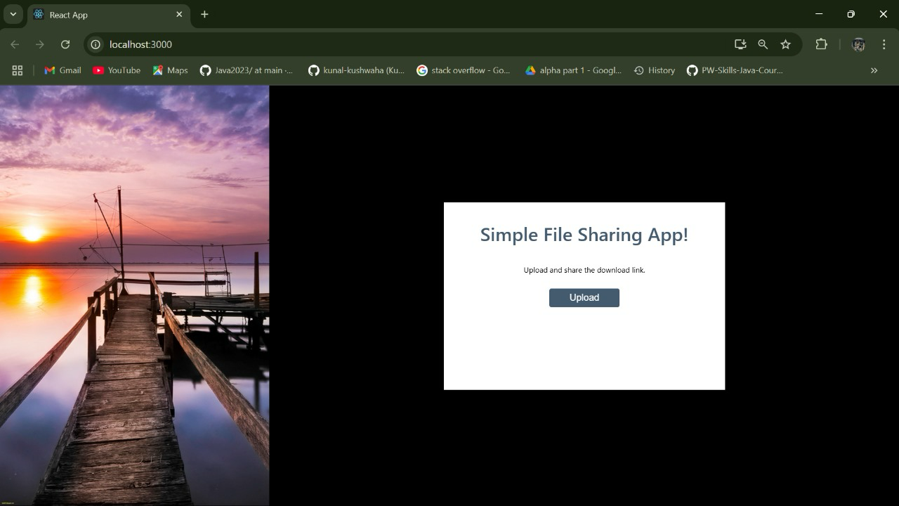
Website snippets or screenshots

Slide 7
Conclusion
Conclusion of the File Sharing System
The development of an efficient, secure, and user-friendly File Sharing System aims to address the growing demands for seamless file exchange in today's increasingly digital world. By focusing on key factors such as security, scalability, cross-platform compatibility, and user accessibility, this system provides an ideal solution for both individual users and businesses seeking to store, manage, and share files effortlessly.
With features like end-to-end encryption, real-time collaboration, version control, and granular access control, the system ensures that files are securely shared without compromising on performance or usability. The integration with popular cloud storage services and the ability to manage large volumes of data without performance degradation offers significant advantages in terms of flexibility and scalability.
Furthermore, the inclusion of mobile support, customizable interfaces, and advanced search capabilities allows users to tailor their experience and access files from any device, anywhere, at any time. The platform’s ability to provide detailed **usage analytics** and **activity logs** ensures transparency and control over shared data, making it particularly useful for teams and organizations.
Ultimately, the **File Sharing System** delivers a reliable, robust, and efficient solution for modern data-sharing needs, empowering users to collaborate effectively and securely, while also ensuring that the system can grow with their needs. Whether for personal use or enterprise-level requirements, this system sets the stage for the future of file sharing by addressing common challenges and offering a seamless experience across all platforms.
---
This conclusion summarizes the benefits and key aspects of the system, reinforcing its value proposition for users and organizations. Let me know if you'd like to refine or expand this!

Slide 8
Challenges Faced
Diverse User Needs: Accommodating a wide range of user preferences for photography styles, decoration themes, and vendor selection.
Scalability for Guest Management: Efficiently managing data for events with up to 300 guests or more, including RSVP tracking, seating arrangements, and preferences.
Vendor Integration: Establishing partnerships with reliable vendors and ensuring seamless communication between users and vendors.
Customization Complexity: Offering flexible yet easy-to-use tools for personalizing decorations, venues, and event schedules to match unique visions.
Data Security and Privacy: Safeguarding sensitive user data, including guest lists, payment information, and personal preferences.

Slide 9
Acknowledgements
A special thank you to my mentor for their invaluable guidance and support throughout this project.
Gratitude to version control system and libraries that made this project possible.
Finally, I appreciate my team members for their collaboration and dedication.

Slide 10


